Slide 1
SCIENTIFIC CALCULATOR
WITH SPEECH FEATURE
BY
BINDU KALE A

Slide 2
INTRODUCTION
We need calculators in our day to day activities from basic to scientific to advanced calculations.
As per my internship project, we were asked to build a Basic GUI Calculator, but as per my interests I have built both basic and scientific mathematical calculator with text to speech converter feature by using python programming.
The calculator uses a graphical user interface (GUI) created with Tkinter, making the calculator easy to use.
It includes speech output so users can hear the results of calculations.
The goal of the project was to create a user friendly scientific calculator, which includes mathematical calculations like trigonometry, logarithms.
Another important aim was to provide speech feedback for accessibility.

Slide 3
Libraries Used in the Program
Among Tkinter, Custom Tkinter, PyQT, etc., libraries I have used Tkinter library to build this GUI project.
I felt it as a simple and perfect for my project as it provided all the necessary elements within Python’s standard.
The math library is used to perform scientific calculations.
I also used a speech module which internally uses PYTTSX3 for text‑to‑speech feature.
Mention libraries from audio helper

Slide 4
Scientific Functions and Extra Functions
This calculator supports several scientific operations like: sine, cosine, tangent.
It also includes logarithm, natural log and square root.
There are power functions like x square, x cube and x to the power y (x², x³, xʸ) and Exponential functions and Percentage and reciprocal operations.
Apart from calculations the calculator also stores the history of previous calculations.
Users can click the history button to view earlier results. And the ability to reuse expressions from history. There is also an option to clear the history.
Error handling displayed directly on the screen if expressions are not entered correctly.

Slide 5
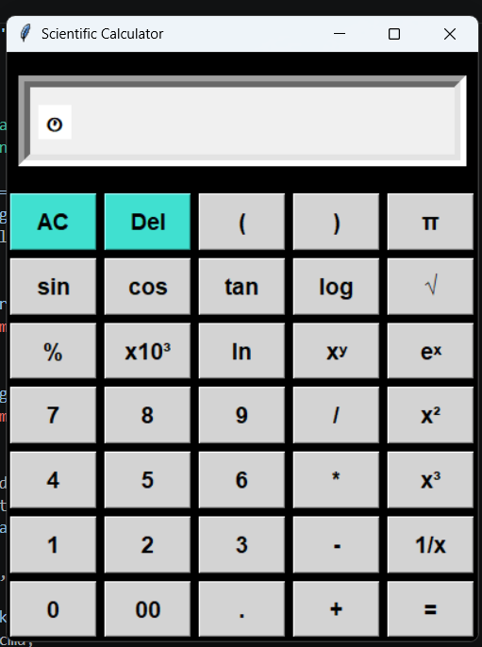

Slide 6
Text‑to‑Speech & Keyboard Features
One special feature that I have added in this calculator is the text‑to‑speech function.
This is implemented using a helper class file that uses the pyttsx3 speech engine.
The calculator speaks button inputs. After calculating, the calculator reads the result aloud digit by digit.
This makes the calculator more interactive.
The calculator also allow the use the keyboard to directly type numbers.
Mathematical operators (+, -, *, /, %) are supported.
Pressing the Enter key in the keyboard will perform the calculation and backspace key deletes characters from the expression.

Slide 7
Accessibility for the Users
The calculator has a simple and clean design.
The background is dark which improves visibility of the buttons.
All buttons are clearly labelled so the user can easily understand them.
It has easy access to history and editing features.
This speech feature can be helpful for people who have difficulty seeing the screen. Users can confirm if they entered numbers correctly.
For example partially blind users can hear the result instead of reading it. They can also confirm whether the calculation they entered is correct.

Slide 8
Conclusion
This project demonstrates that how GUI Programming in Python can be used to build practical applications.
It combines mathematical functionality with accessibility features.
The speech feature makes the calculator more useful for a wider range of users.
Shows how programming can create practical real‑world tools.

Slide 9
THANK YOU

